Slide 1
C.A.R. YPN Week of Giving
Presented by YPN Leadership
July 16, 2015

Slide 2
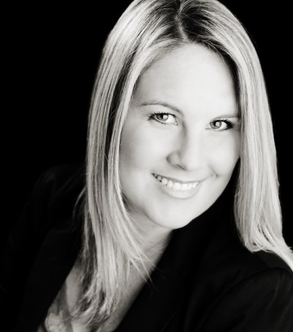
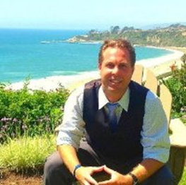
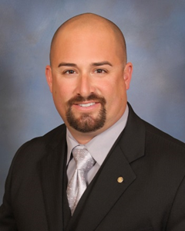
2015 Leadership
Sarah Trent Miranda, Chair
Citrus Valley AOR
Pasadena, Los Angeles & The San Gabriel Valley sarah.trent@theboutiquere.com
Matt Clements, Vice Chair
Orange County AOR
Laguna Niguel, Laguna Beach surferrealtor@gmail.com
Adam Ruiz, Vice Chair
Southwest Riverside AOR
Temecula, Murrieta, Southwest Riverside County adam@1stActionRealEstate.com

Slide 3
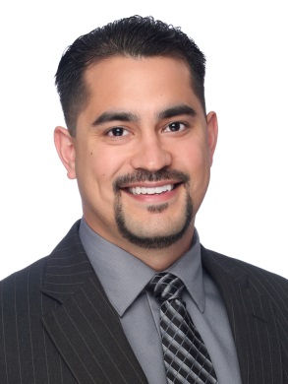
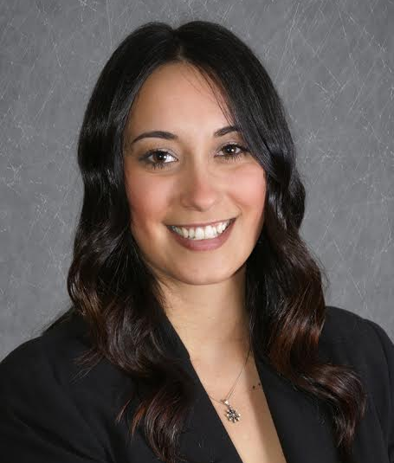
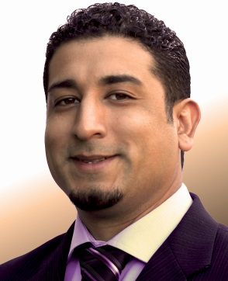
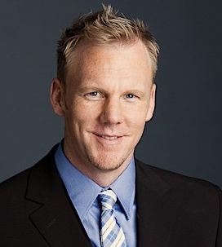
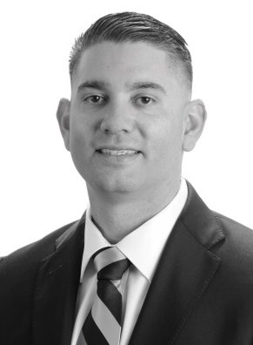
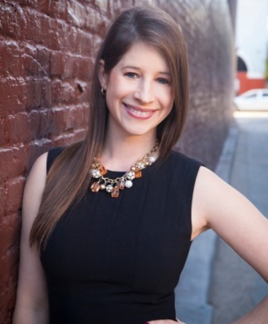
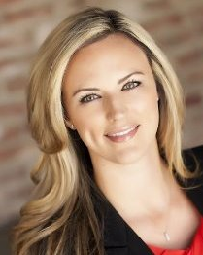
2015 Advisory Board
Anthony Andaya
Pacific Southwest AOR
San Diego anthony.andaya@gmail.com
Ricardo Archila
San Mateo County AOR
San Mateo, San Carlos, Belmont gotarealtor@yahoo.com
Jessica Depper
Scenic Coast AOR
San Luis Obispo, Paso Robles, Morro Bay
jessicadepper@gmail.com
Carol Farrar
North San Diego County AOR
San Diego, Del Mar, Encinitas, Carlsbad carol@1850realty.com
Krista Knight
Central Valley AOR
San Mateo, Sacramento, Stanislaus, San Joaquin kristaknightrealtor@gmail.com
Doug Sager
Oakland AOR
Oakland, Berkeley, Emeryville dougsagerhomes@gmail.com
Nick Solis
Contra Costa AOR
Walnut Creek, Danville, Pleasanton, Brentwood nick@realnicksolis.com
Erin Steele
Affiliate Ambassador
Pleasanton erins@wellsfargo.com

Slide 4
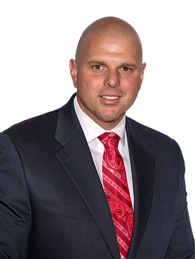
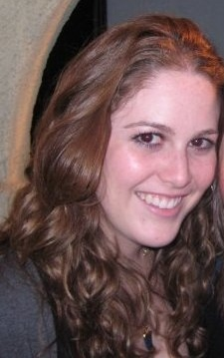
2015 Committee Liaison and C.A.R. Staff
Jared Martin Committee Liaison
Fresno AOR jared.kw@gmail.com
Lindsey Moss
C.A.R. Staff lindseym@car.org

Slide 5
YPN Mission Statement
YPN helps young real estate professionals excel in their careers by giving them the tools and encouragement to become involved in four core areas:
REALTOR® associations. Attend REALTOR® conferences and pursue leadership roles with their local, state, and national association.
Real estate industry. Take an active role in policy discussions and advocacy issues; be informed about the latest industry news and trends
Peers. Network and learn from one another by attending events, participating in online communication, and seeking out mentoring opportunities
Community. Become exceptional members of their community by demonstrating a high level of REALTOR® professionalism and volunteering for causes they feel passionate about.

Slide 6
Join Up & Give Back (The Basics)

Slide 7
What is the C.A.R. YPN Week of Giving?
A Week To Give Back to Your Local Community
August 10-16th
Local Associations and YPNs Across California will be Contributing to a Cause of Their Choice During the Same Week
This is Your Local Event, C.A.R. YPN is Just Providing the Platform

Slide 8
How to Get Started
Choose a Day, Weekend, the Entire Week, or Combination for Your Event!
Choose whatever works best for your YPN and AOR
Select Charitable Cause or Event in Your Area to Give Back To
Cleaning the Beach, Serving Meals at a Shelter, Painting Homes
Sign People Up To Participate from Your Entire Association
Can Team Up with Neighboring Associations!

Slide 9
Give Me the Deets

Slide 10
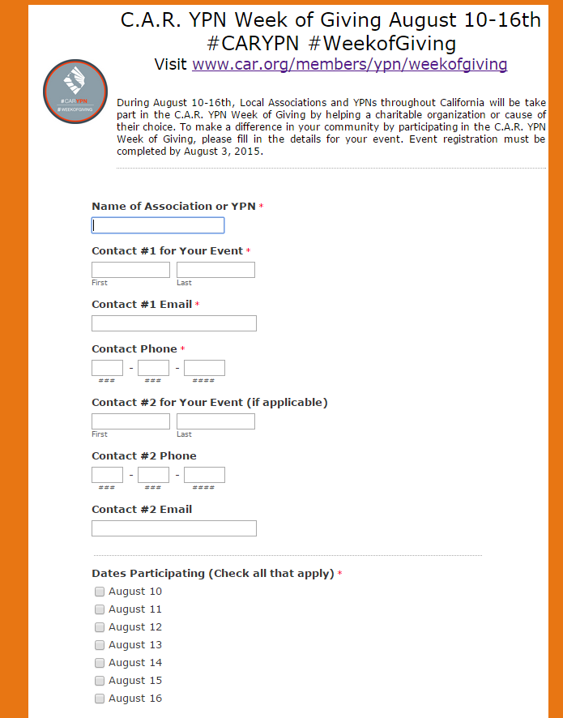
What Do You Need to Do?
Choose Your Event, Complete Online Registration Form by August 3rd
http://on.car.org/2015weekofgiving
Basics like Group Name, Contact Information, Day(s) Participating, Cause, Expected Attendance
More Event Information Available at http://www.car.org/members/ypn/weekofgiving/

Slide 11
What Do You Need to Do?
Order T-Shirts by July 20th
Front of Shirt Will Have Set Design, Customize the Back!
Add your Logo and/or Sponsor to the Back
$10-15/shirt Depending on Order
We Suggest Getting Sponsorship to Help Cover Your T-shirt Costs
Contact Bob Browning bob@calsigns.net

Slide 12
Promote, Promote, Promote!

Slide 13
Marketing
Marketing Materials Available at http://www.car.org/members/ypn/weekofgiving/
Logo
Customizable Flyer (if you don’t have Adobe Professional to edit, contact Lindsey Moss)
Newsletter and Social Media Templates (COMING SOON!)
Event Hashtags: #CARYPN #WeekofGiving

Slide 14
Let’s Recap

Slide 15
Your Checklist
Before the Event
Order T-Shirts (July 20th)
Complete Online Registration Form (August 3rd)
Promote with Your Membership and Get Members Signed up!
During the Event
Post on Social Media and Include #CARYPN #WeekofGiving
Take at Least 3 Photos From the Event to Share (Video too!)
After the Event
Complete Online Form After (link to form will be provided later)
“Charity Amount Given” (i.e. Miles cleaned, Houses Painted)
Total Numbers of Members who Participated
Submit Photos and Video to lindseym@car.org

Slide 16
Q&A

Slide 17
THANK YOU!

