Slide 1
Welcome to
C.A.R. Legal Live Webinar
Our webinar will begin at 1:30 p.m.
Handouts for today’s presentation are available at http://www.car.org/legal/LegalWebinars/live/.
To get audio, turn on volume on your computer speakers or phone in using the information on your attendee control panel. If you experience audio problems while using your computer speakers, try phoning in instead.
Example

Slide 2


Electronic Signatures: Entities and zipLogix Digital Ink®
C.A.R. Legal Live Webinar
Neil Kalin, Assistant General Counsel, Moderator
Fatima Sogueco, Presenter
Copyright© 2016 CALIFORNIA ASSOCIATION OF REALTORS® (C.A.R.). Any reproduction or use of this material is strictly prohibited without the express written permission of the C.A.R. Legal Department. All rights reserved. The information provided in this presentation is intended as general advice, and is not intended as a substitute for individual legal advice. The information in this presentation is not intended to nor does it create a standard of care for real estate professionals.

Slide 3
Questions?
To ask a question, type it in the questions box on your attendee console.
Do not ask a question involving a current transaction with an agent in another office. Direct that type of question to the Legal Hotline at (213) 739-8282.
Sorry but we may not have time to get to everyone’s question.

Slide 4

zipLogix Digital Ink® and Entities
Fatima Sogueco
zipForm® Product Supervisor
fatimas@car.org

Slide 5
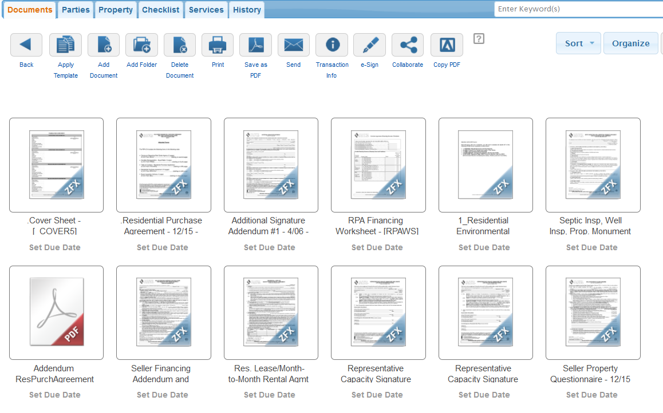
Getting started Log-in to zipForm® Plus

Slide 6
While filling out the RPA-CA or RCSD forms, when there is an entity acting as buyer or seller, follow these steps to include both the entity and signer on your form!

Slide 7
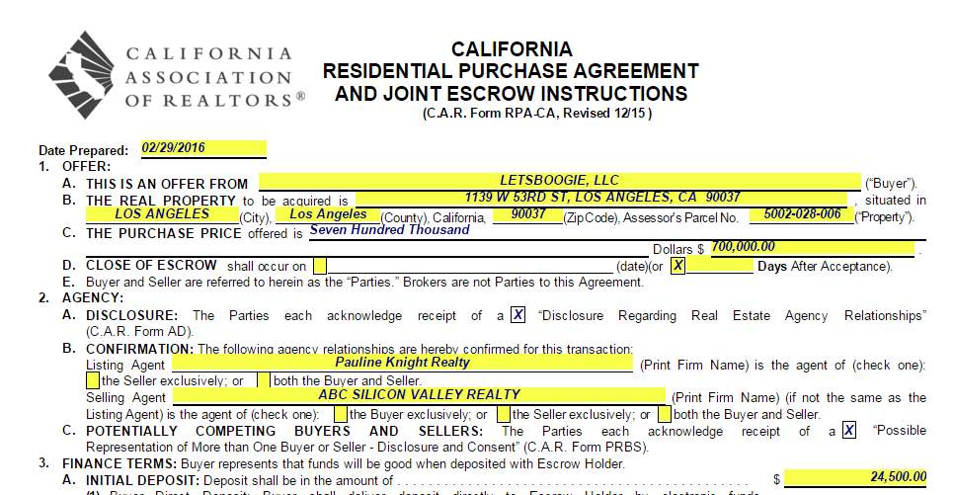
Step One: Fill out the Buyer’s information on section 1-A of the RPA-CA form

Slide 8
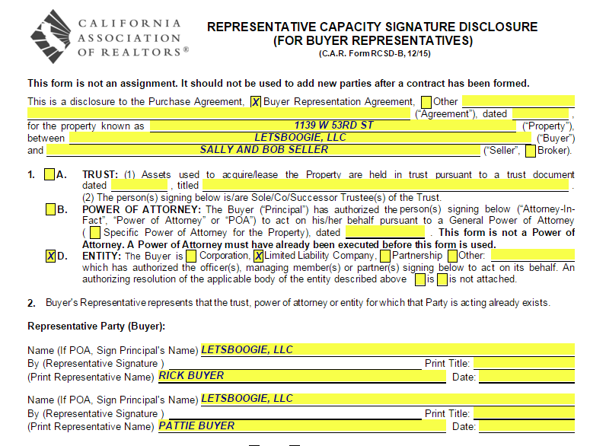
Step Two: Fill in the Entities information on section 2 of the RCSD-B form

Slide 9

What if the Seller is a Trust?

Slide 10
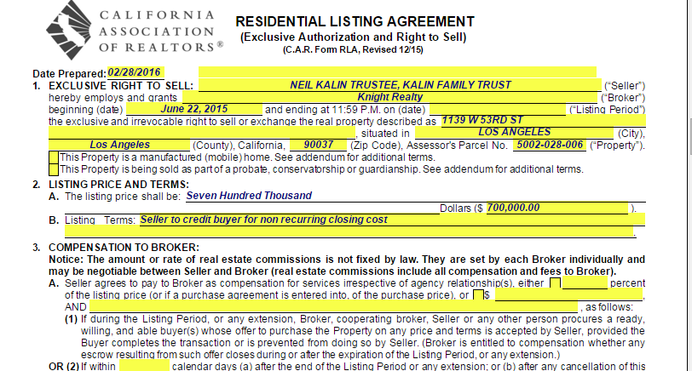
Step One: Fill out the Sellers information on section 1 of the RLA form

Slide 11
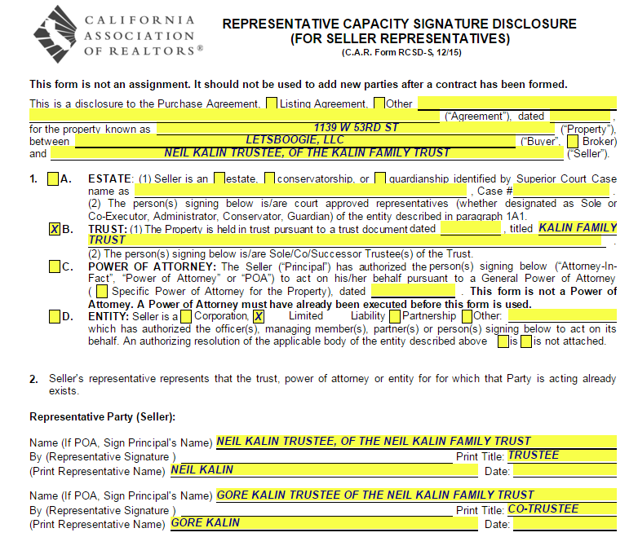
Step Two: Fill in the Entities information on section 2 of the RCSD-S form

Slide 12

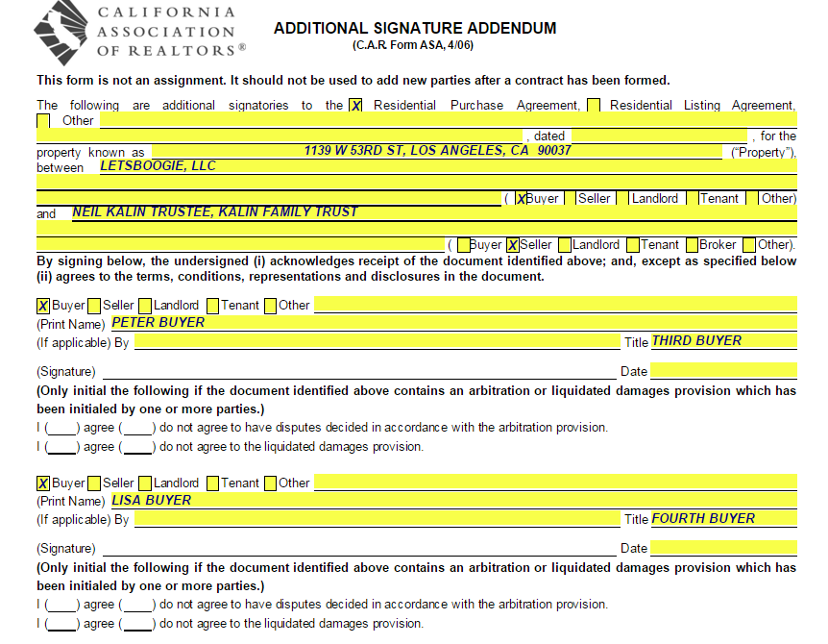
Question:
What if there are more than two Buyers or more than two Sellers in my transaction?
Answer:
Use the Additional Signature Addendum (CAR Form ASA)

Slide 13
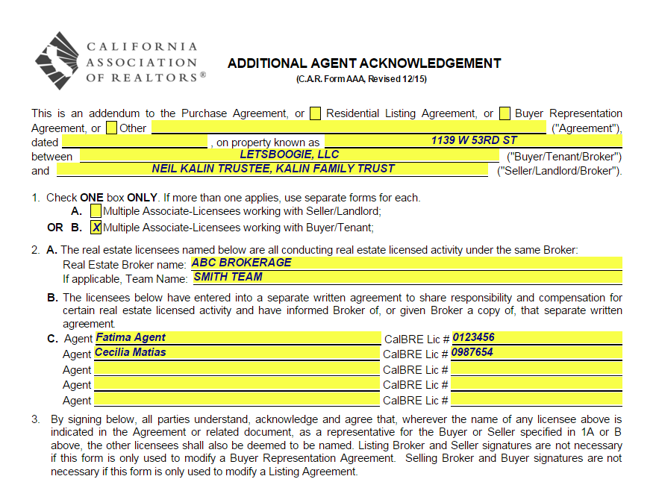
Tip! Use form Additional Agent Acknowledgement with principals that two or more agents in same brokerage are working as partners or team for a specified buyer or seller

Slide 14
How to use zipLogix Digital Ink®

Slide 15
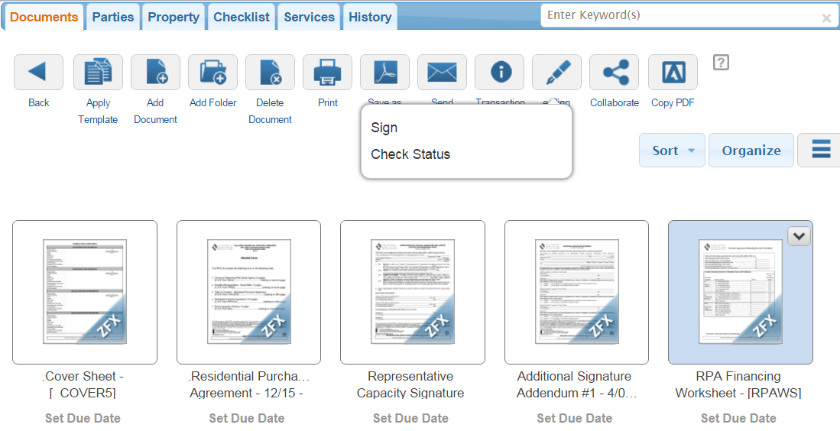
Step One: Send for signatures: Click eSign
Send documents to be signed electronically using zipLogix Digital Ink ® (select your e-signing software in your zipForm ® Plus profile).
eSign

Slide 16
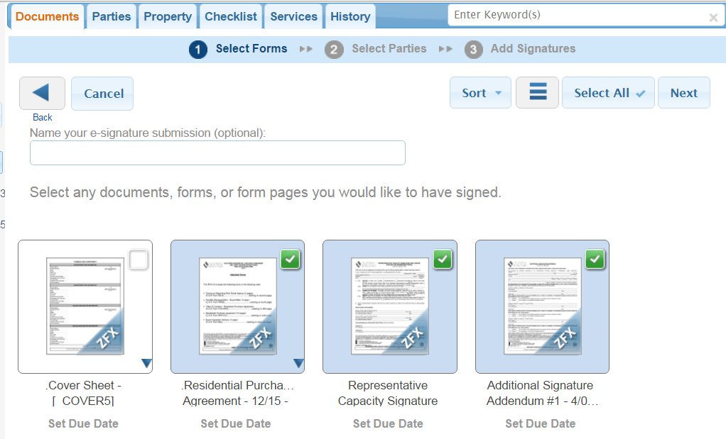
Step Two: Select forms
2. Next
1. Select
Notes:
Forms or PDF documents saved in this zipForm® file can be added for signing.
Click each document or PDF to select it for the signing packet. (Tip: Use the Select All button to select all forms and PDF documents in this zipForm® Plus file)
Click and drag documents to sign to organize the order for documents. (Tip: Add a new PDF for signing (without saving it in zipVault® first) by clicking the Browse button above the list of documents)
Click Next

Slide 17
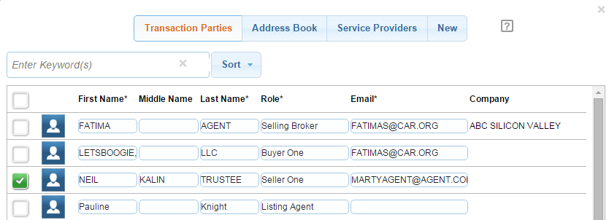
Transaction Parties for Trustees

Slide 18
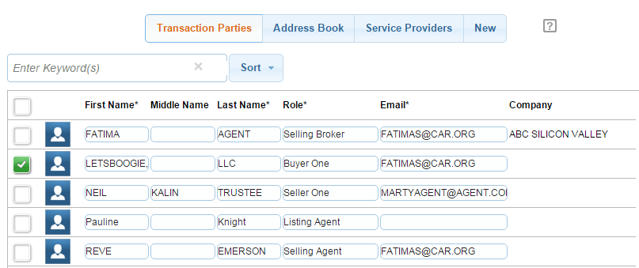
Transaction Parties for LLC’s

Slide 19
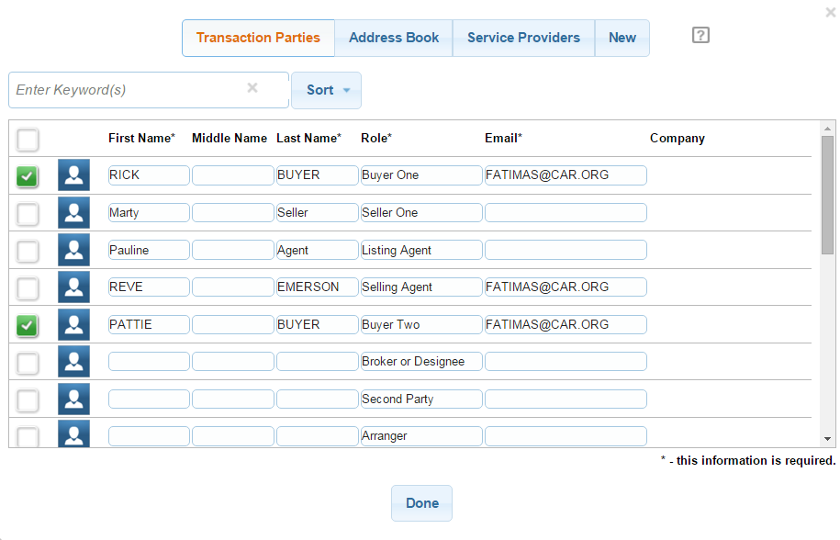
Step Three: In the Transaction Parties window, delete the entity name and replace with the signer’s name.

Slide 20
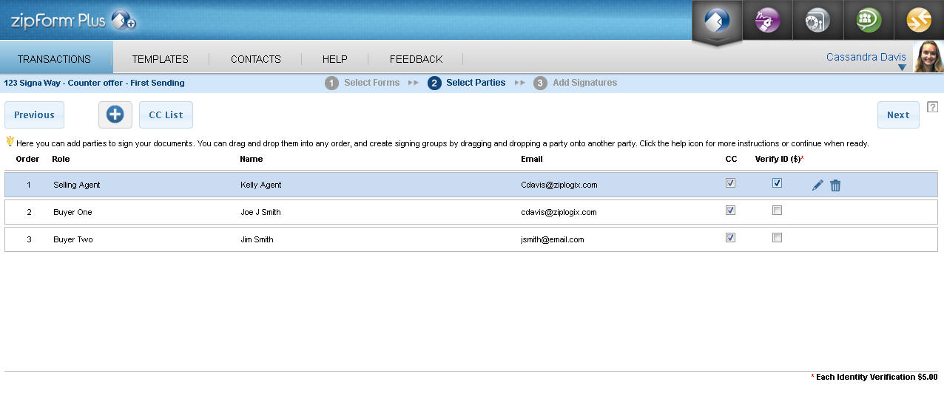
Steps Four and Five: Click and drag signers to change the signing order. Drag two signers on top of each other to prompt them to sign at the same time.
5. Next
4. Drag and drop

Slide 21
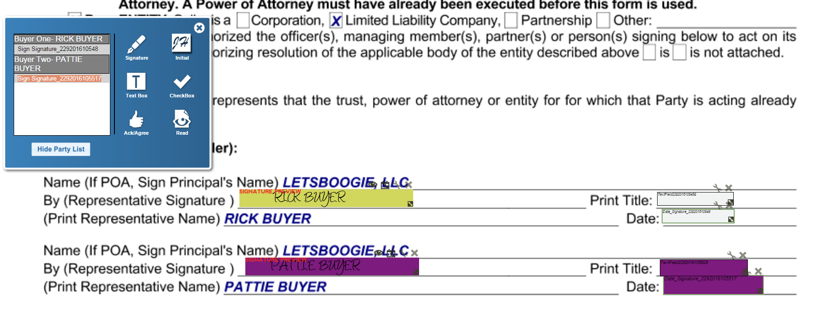
Steps Six: Click and drop a Signature task for each signers. Click Send when finished. Tip: With the signature highlighted, you will now notice that the Text Box and Checkbox icons are now available. Drag the desired icon over to the form.

Slide 22
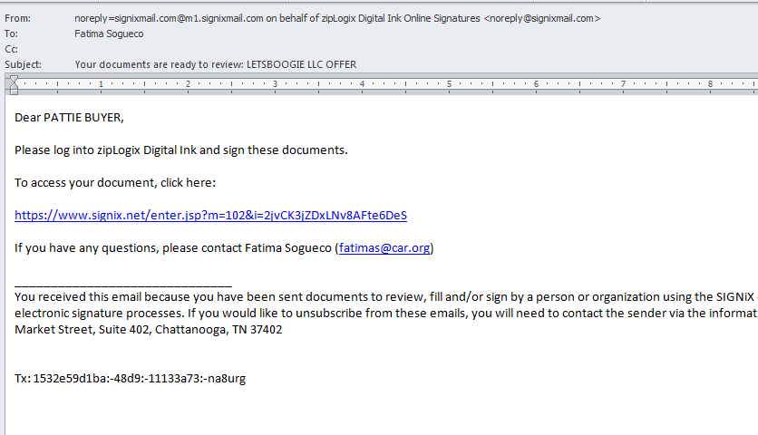
Email automatically sent to first signer

Slide 23
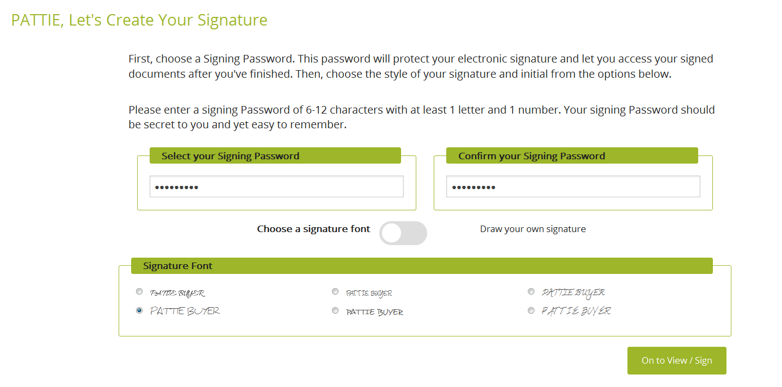
Signing: Two ways to create a Signature Option one: Select a Signature Font

Slide 24
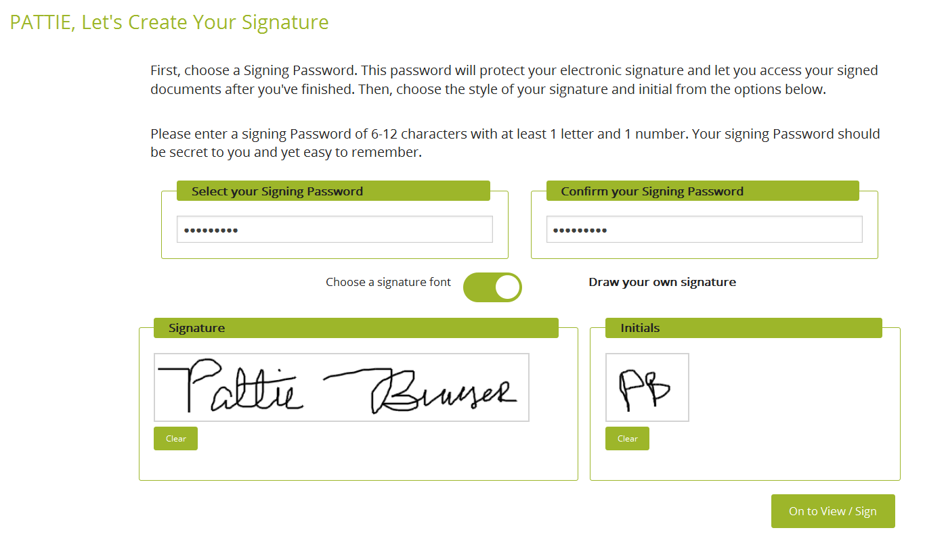
Option two: elect Draw Your Own Signature

Slide 25

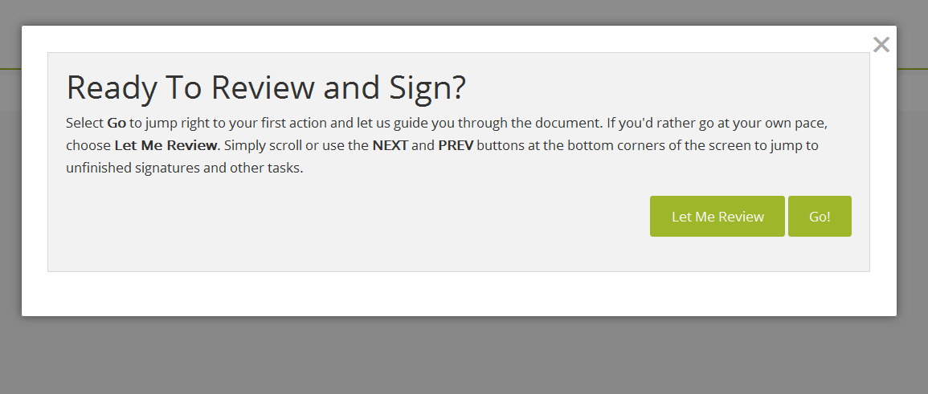
Make sure your signers are aware of the two options available to review the documents before signing

Slide 26
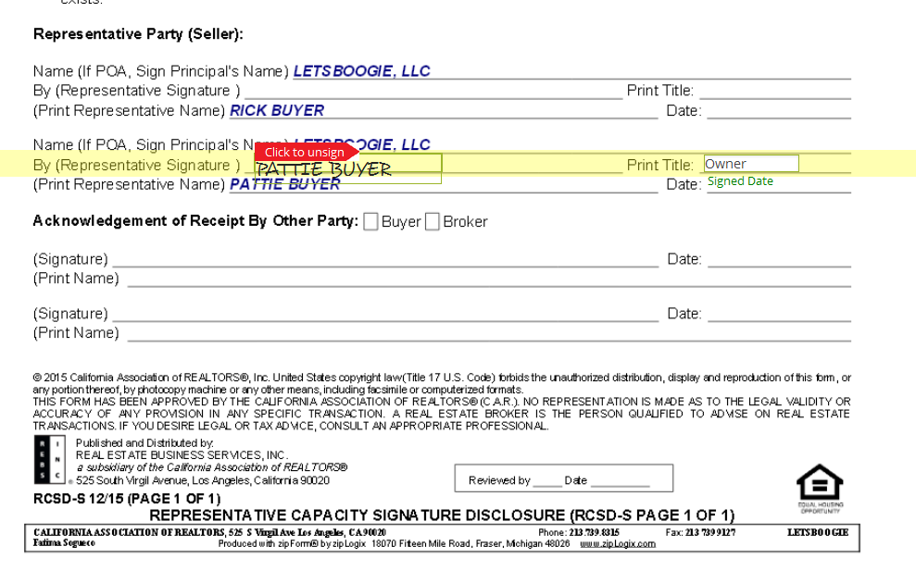
Click to Sign and type the information in the Text field

Slide 27
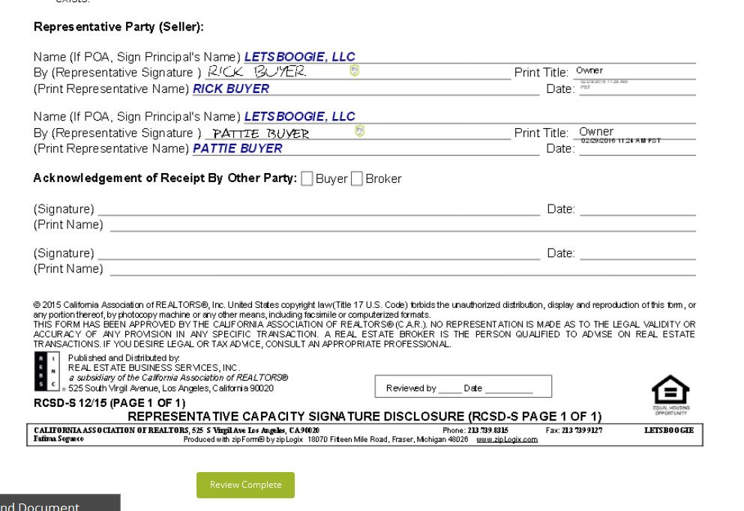

Slide 28
How to use zipLogix Digital Ink® from your Tablet device

Slide 29
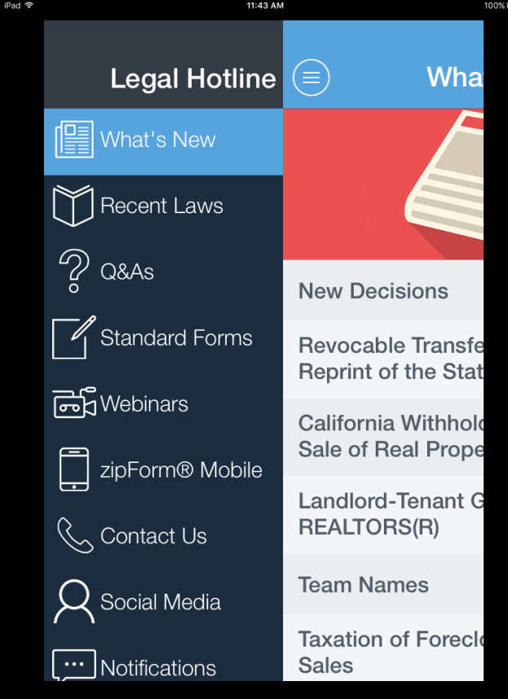

Access zipForm® Mobile using the FREE C.A.R. Legal Hotline App

Slide 30
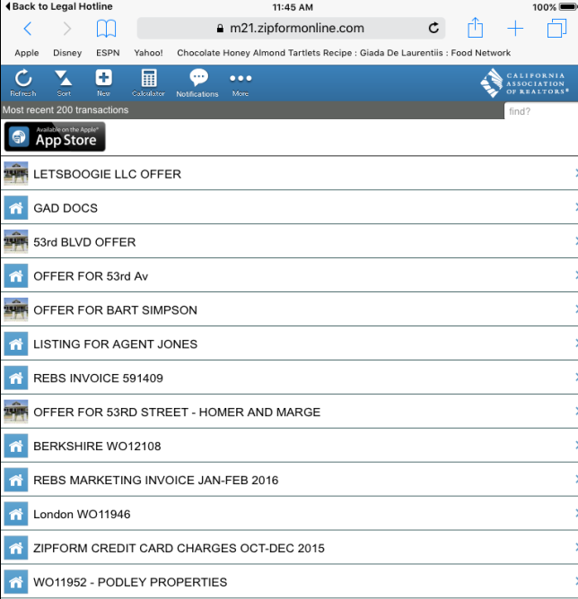
Step One:
Tap to Edit existing Transaction

Slide 31
Step Two: Fill out the Buyer’s information on section 1-A of the RPA-CA form

Slide 32
Step Three: Fill in the Entities information on section 2 of the RCSD form

Slide 33
How to use zipLogix Digital Ink®

Slide 34
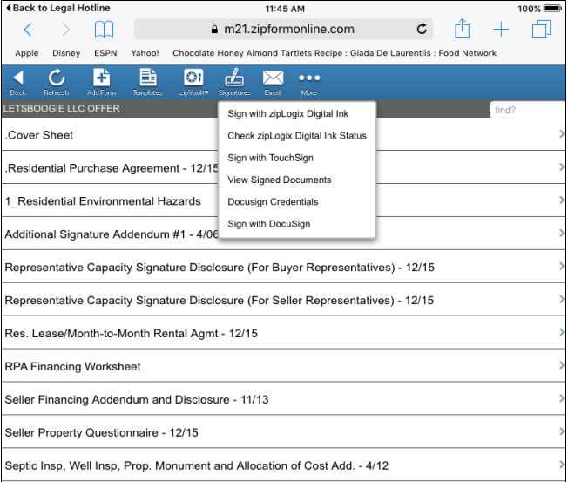
Step One:
Tap Signatures icon from the toolbar and select Sign with zipLogix Digital Ink

Slide 35
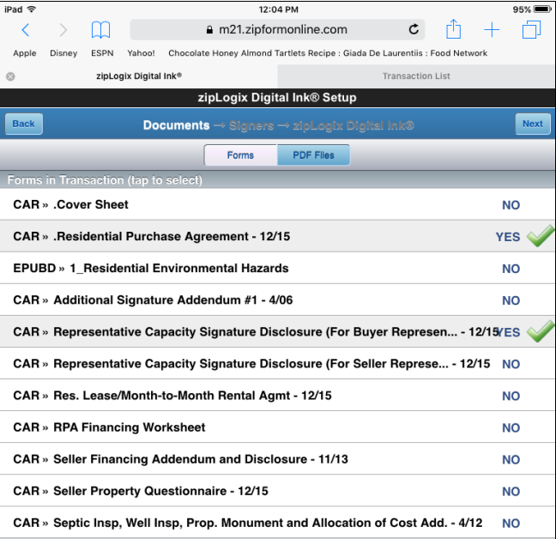
Step Two:
Tap to select forms for E-sign

Slide 36
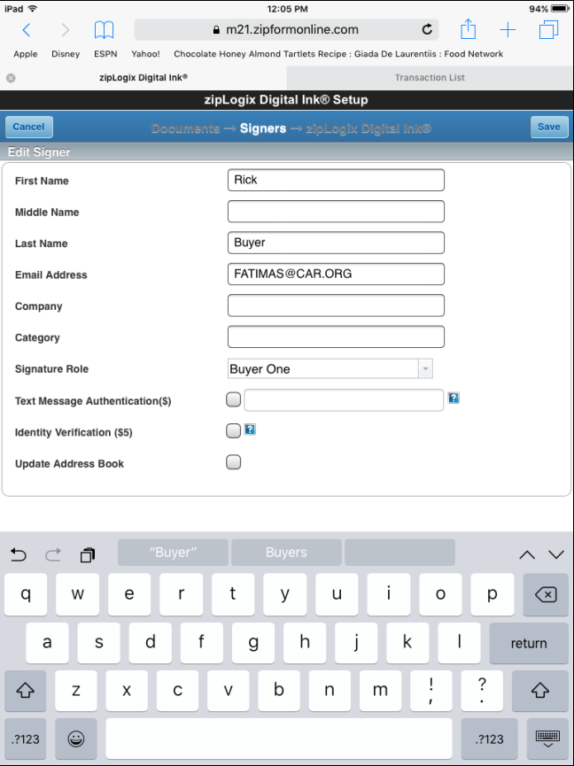
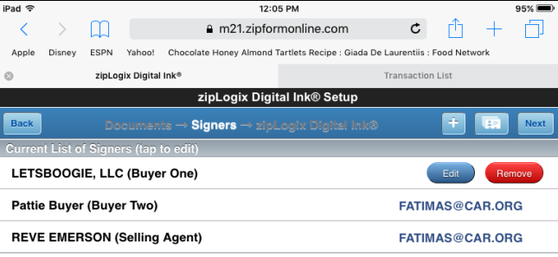
Steps Three and Four:
Select and Edit Signers’ Information

Slide 37
Steps Six: Click and drop a Signature task for each signers. Click Send when finished. Tip: With the signature highlighted, you will now notice that the Text Box and Checkbox icons are now available. Drag the desired icon over to the form.

Slide 38
Email automatically sent to first signer

Slide 39
Signing: Two ways to create a Signature Option one: Select a Signature Font

Slide 40
Option two: elect Draw Your Own Signature

Slide 41
Click to Sign and type the information in the Text field

Slide 43
Enable zipLogix Digital Ink®
Member Benefit of the California Association of REALTORS®
Directly integrated with zipForm® Plus, Standard and Mobile editions
No extra usernames or passwords to remember.
Check the status of signed contracts directly from zipForm®.

Slide 44
zipLogix Digital Ink® System Requirements
It is important that you view a zipLogix Digital Ink® signed document using Adobe Acrobat
The Adobe PDF viewer is free, and can be downloaded at www.Adobe.com
Using a different viewer, you might not see the signature properly
It is especially important to remember this for Apple computers. The Apple Preview function will not properly show the signatures.

Slide 45
Thank You
For additional training on zipLogix Digital Ink® visit
www.youtube.com/ziplogix
For questions and comments, send an e-mail to training@car.org
Notes:
Thank you for joining us in our training today! We hope it was educational.
Here are some helpful links for contacting ZipForm® or finding additional help.

Slide 46
Questions?
To ask a question, type it in the questions box on your attendee console.
Do not ask a question involving a current transaction with an agent in another office. Direct that type of question to the Legal Hotline at (213) 739-8282.
Sorry but we may not have time to get to everyone’s question.

Slide 47

Announcements
Legal Live Webinar http://www.car.org/legal/LegalWebinars/live/
Recorded version of this webinar should be available by Wednesday.
Upcoming monthly webinars:
April 5, 2016 1:30-2:30 pm, Topic: CalBRE Audits
Twitter : follow us on twitter @CARealegal
Legal Hotline App: go to your app store or http://www.car.org/legal/app/

Slide 48
Thank You
For legal questions, C.A.R. members may call our Legal Hotline at (213) 739-8282 or write to “Contact Us” at www.car.org.
If you have any suggestions or comments about this webinar, email neilk@car.org.

